Slide 1
TEAM NAME: DEXTER
TEAM MEMBERS:
Neelam Somai (Group Leader)
Gayatri Patil
Yash Mate
Gaurav Tirodkar
TITLE : Optimized Warehouse Management of Perishable Goods for a Food Delivery Company
IBM Hack Challenge 2020

Slide 2
PROBLEM DESCRIPTION
A food delivery service has to deal with a lot of perishable raw materials which makes it all, the most important factor for such a company is to accurately forecast daily and weekly demand. Too much inventory in the warehouse means more risk of wastage, and not enough could lead to out-of-stocks - and push customers to seek solutions from your competitors. The replenishment of majority of raw materials is done on weekly basis and since the raw material is perishable, the procurement planning is of utmost importance.

Slide 3
OBJECTIVES
Forecasting demand for every product in every warehouse
Robust Database Architecture
Gradient Boosting Machine Learning
Interactive Visualization
An integrated virtual assistant
Sentiment Analysis
Tone Analyzer to predict the sentiment of users review.

Slide 4
LITERATURE SURVEY
Snappi Warehouse:
Track goods shipped in and out
Create supply records
LoMag Warehouse Management:
Import Data from excel
Create & restore backup copy
Inventory Now:
Get a snapshot of your inventory

Slide 5
TECH STACK
Programming Languages & Frameworks:
Python 3
IBM Watson Studio
IBM Cloud for Deployment
IBM Node-Red
IBM DB2
IBM Tone Analysis
ML Libraries for Prediction:
Tensorflow
Keras
Sklearn
Numpy
Pandas
Scipy
xgboost

Slide 6
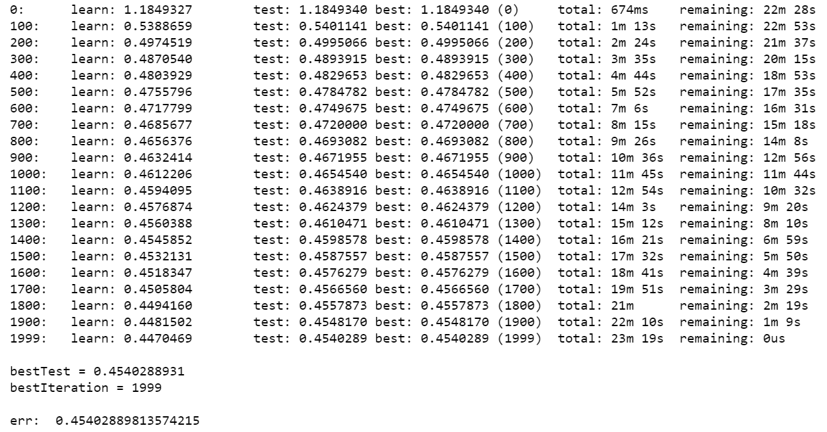
ML PREDICTION USING CATBOOST

Slide 7
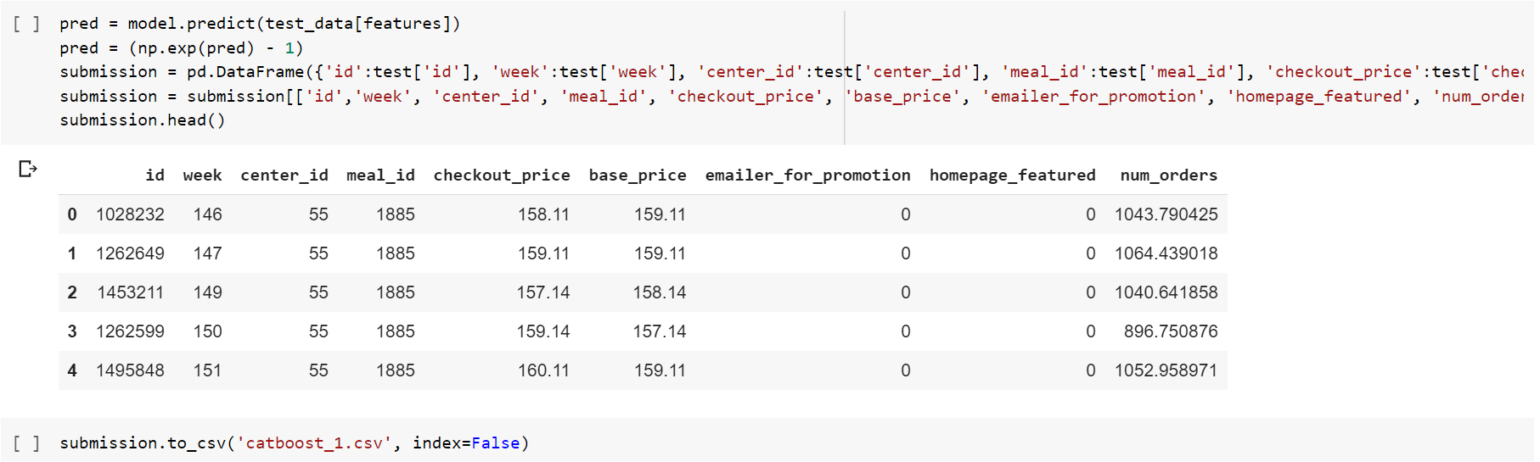
ML Prediction: Predicted Output

Slide 8
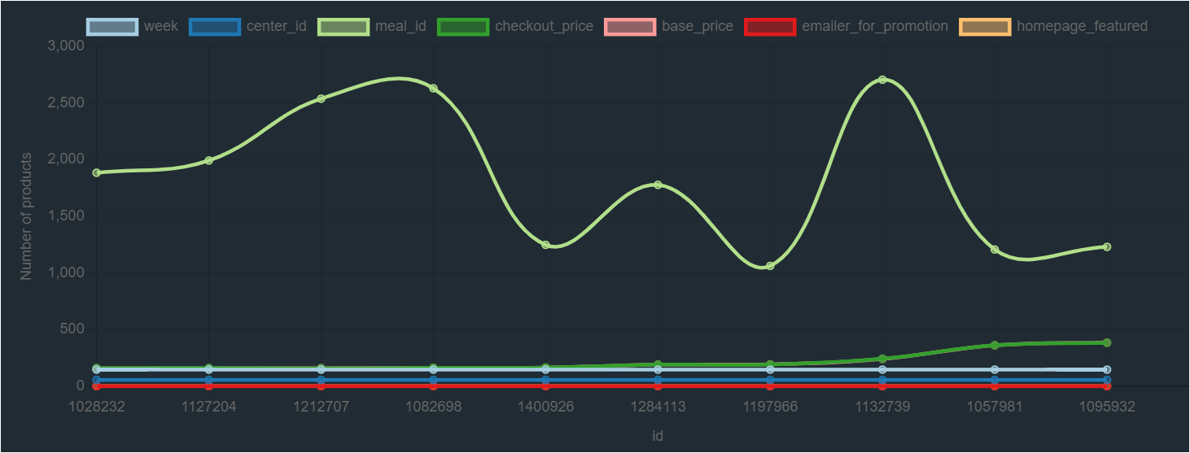
HOME PAGE - Dynamic Chart

Slide 9
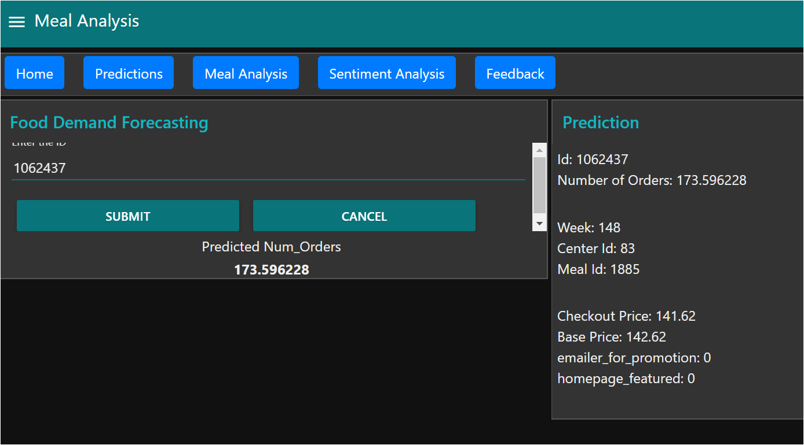
UI - Prediction Visualization

Slide 10
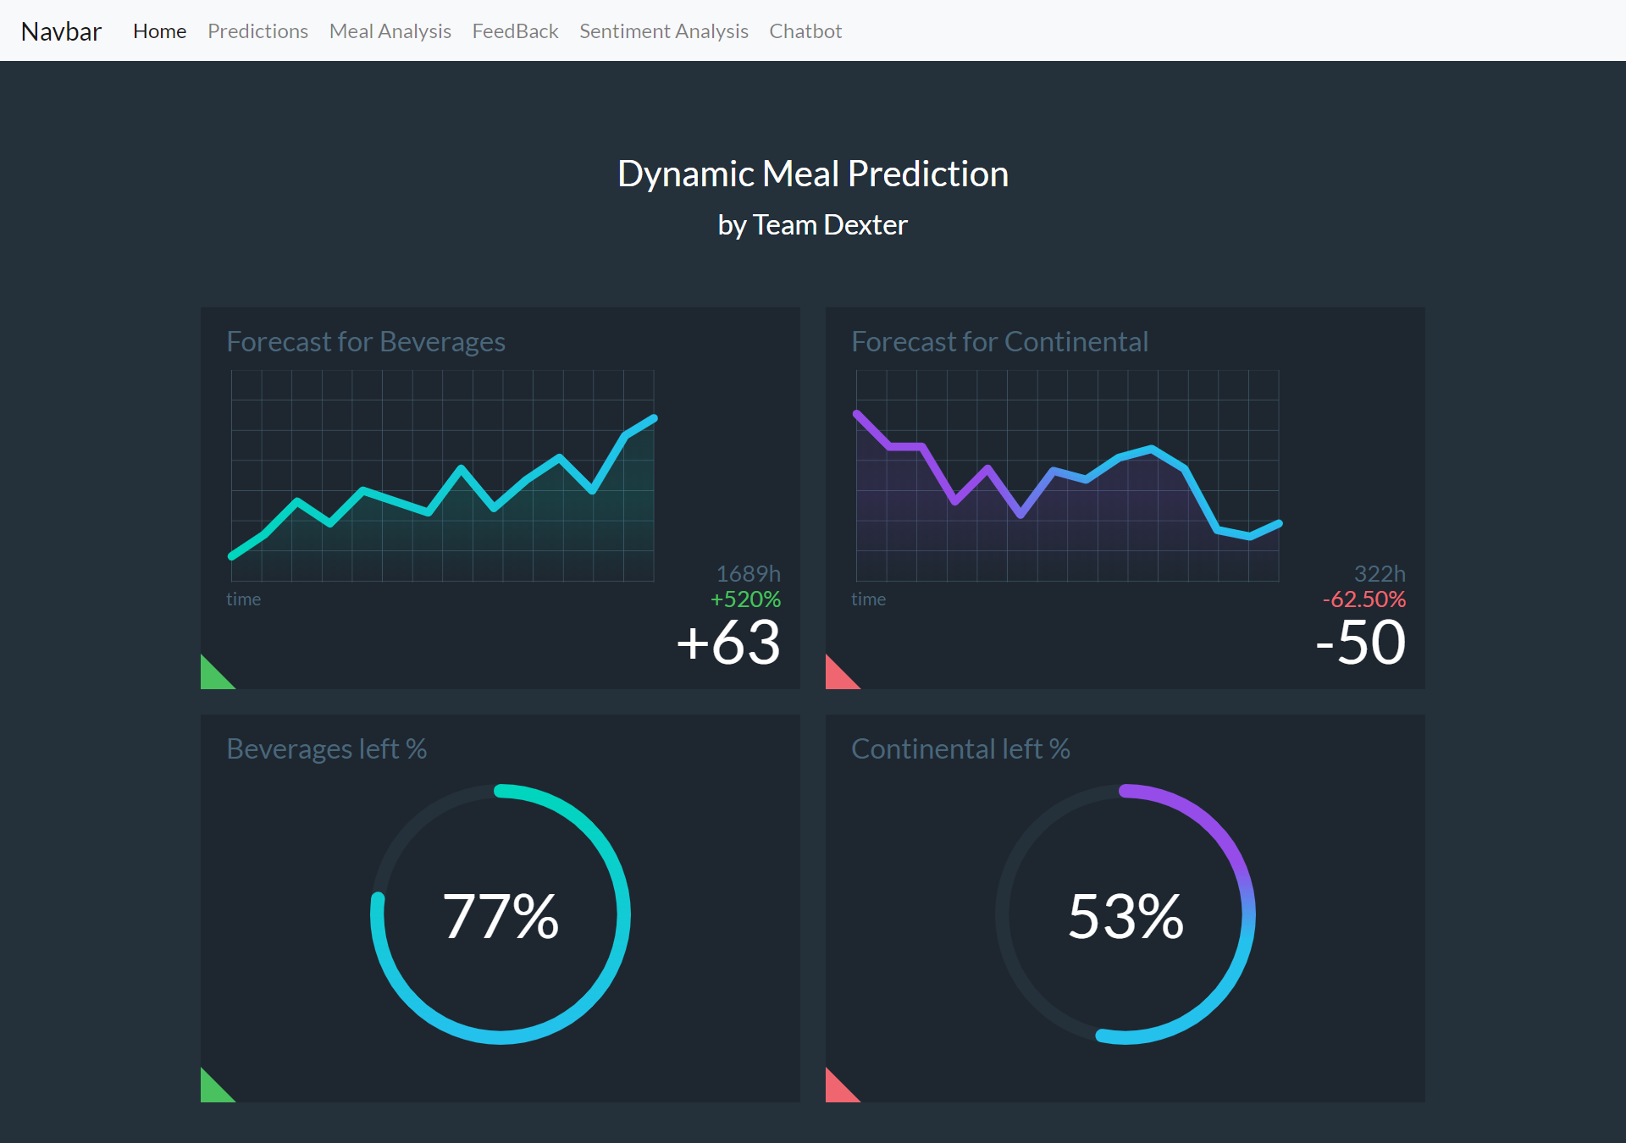
UI - Meal Analysis

Slide 11
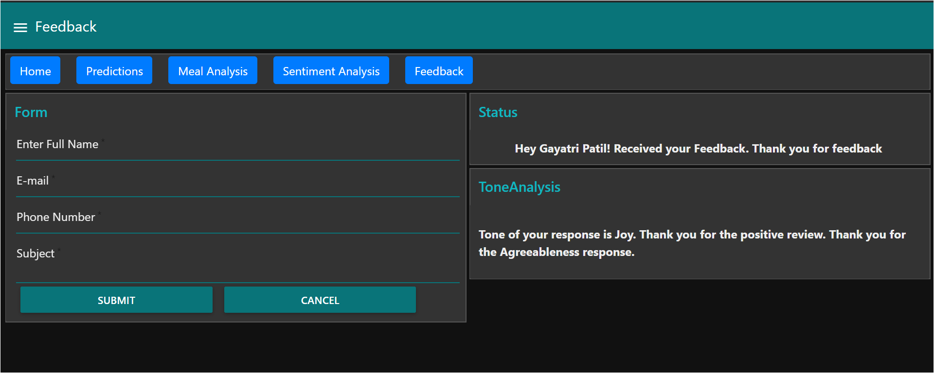
UI- Feedback Form and Tone Analysis

Slide 12
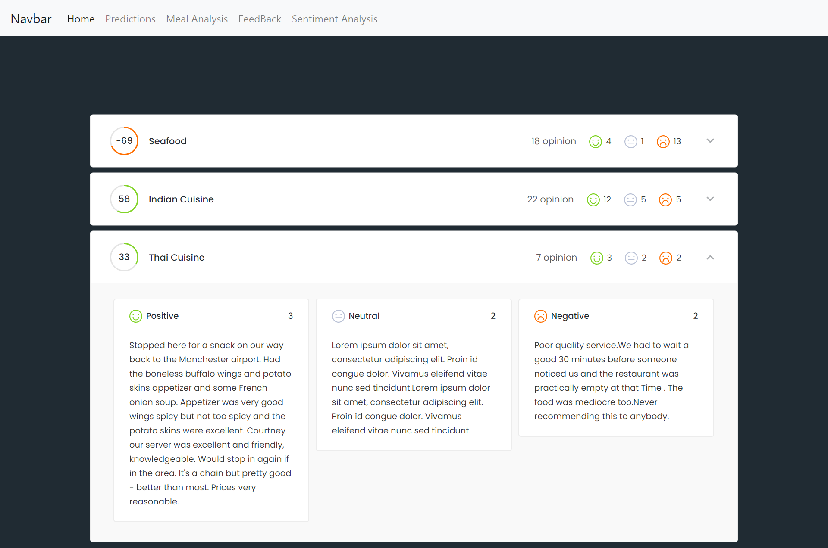
UI - Sentiment Analysis

Slide 13
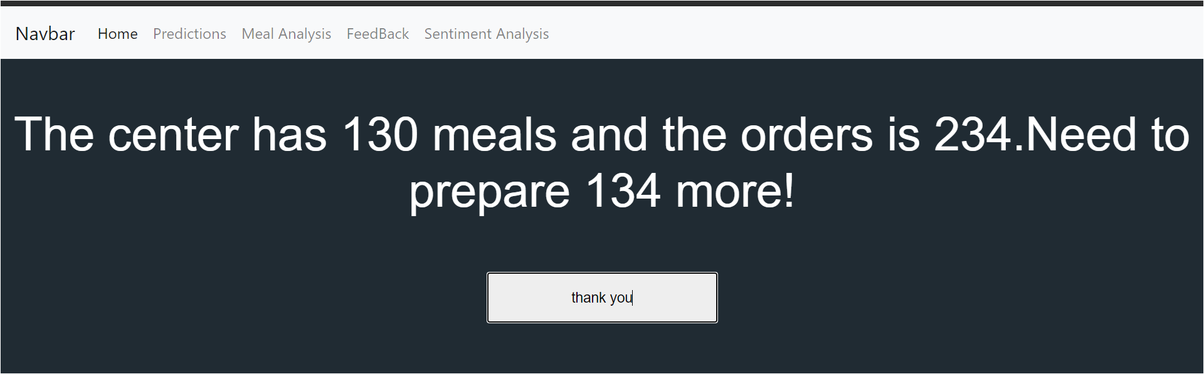
UI - ChatBot

Slide 14
BUSINESS IMPACT
BEFORE
Items used to perish in the warehouse only.
Shortage of food items due to high demand.
Due to low accuracy of existing systems, inadequate or insufficient orders were placed.
Monitoring of resources was manhandled leading to low efficiency.
No help of statistics to analyze patterns.
AFTER
Accurate prediction with ML assistance on requirements.
Data visualisation graphs for warehouse owners
analyze and make smart business decisions.
Virtual Assistance
Tone Analysis of Feedback

Slide 15
HURDLES & EXPERIENCE
HURDLES
Could not find IBM ML support for Catboost Model
Lack of online resources for using csv node in Node-Red
Integrating ui builder node with Node-Red dashboard
EXPERIENCE
Hands on experience with cloud services
Excellent courses offered
Project management and implementation systematically

Slide 16
CONTRIBUTION
Neelam Somai:
Research and UI design
Documentation
Gayatri Patil:
UI and Integration
Deployment
Gaurav Tirodkar:
ML Prediction
Dashboard
Yash Mate:
ML Model
Functionalities

Slide 17
THANK YOU !

